Slide 1

ABHAY KUMAR
REGISTRATION NUMBER : (42310001)
ROLL NUMBER : (22S315008)
M.E : (CSE)

Slide 2
PROJECT TITLE:
HEART DISEASE PERDICATION USING MACHINE LEARNING ALGORITHMS:

Slide 3
Presentation Outline
Abstract
Introduction
Domain
Literature Survey
Methodology
Application
System Architecture
Architecture Of Predication System
System Configuration
Machine Learning
Machine Learning Algorithms
Predication Of Disease
Data Set Details
Example Of Confusion For Matrix Accuracy (Performance Analysis)
Machine Learning Algorithms Performance Analysis Results (1) Svm 2) Knn 3) Random Forest 4) Xg-Boost 5) Ada-Boost) 6) ANN 7) DNN 8) Linear Regression 9) Logistic Regression 10) Naïve Bayes 11) Decision tree
Coadding And Testing
Simple Code
Results From The Test Data Set
Results
Conclusion And Future Work
References

Slide 4

Abstract:
Heart is one of the most important part of the body. It helps to purify and circulate blood to all parts of the body. Most number of deaths in the world are due to Heart Diseases. Some symptoms like chest pain, faster heartbeat, discomfort in breathing are recorded. This data is analyzed on regular basis. In this review, an overview of the heart disease and its current procedures is firstly introduced. Furthermore, an in-depth analysis of the most relevant machine learning techniques available on the literature for heart disease prediction is briefly elaborated. The discussed machine learning algorithms are Decision Tree, SVM, ANN, Naive Bayes, Random Forest, KNN. The algorithms are compared on the basis of features. We are working on the algorithm with best accuracy. This will help the doctors to assist the heart problem easily

Slide 5
Introduction:
Heart disease is the kind of disease which can cause the death. Each year too many peoples are dying due to heart disease. Heart disease can be occurred due to the weakening of heart muscle. Also, the heart failure can be described as the failure of heart to pump the blood. Heart disease is also called as coronary artery disease (CAD). CAD can be occurred due to insufficient blood supply to arteries. Heart disease can be detected using the symptoms like high blood pressure, chest pain, hypertension, cardiac arrest, etc. There are many types of heart diseases with different types of symptoms. Like: 1) heart disease in blood vessels: chest pain, shortness of breath, pain in neck throat., 2)heart disease caused by abnormal heartbeats :slow heartbeat, discomfort, chest pain., etc. Most common symptoms are chest pain, shortness of breath, discomfort, chest pain., etc. Most common symptoms are chest pain, shortness of breath, fainting. Causes of heart disease are defects you’re born with, high blood pressure, diabetes, smoking, drugs, alcohol. Sometimes in heart disease the infection also which affects the inner membrane which is identified by symptoms like fever, fatigue, dry cough, skin rashes. Causes of heart infection are bacteria, viruses, parasites. Types of heart disease: Cardiac arrest, Hypertension, Coronary artery disease, Heart failure, Heart infection, Congenital heart disease, Slow heartbeat, Stroke type heart disease, angina pectoris. Now a days there are too many automated techniques to detect the heart disease like data mining, machine learning, deep learning, etc. So, in this paper we will brief introduction about machine learning techniques. In this we train the datasets using the machine learning repositories. There are some risk factors on the basis of that the heart disease is predicted. Risk factors are Age, Sex, Blood pressure, Cholesterol level, Family history of coronary illness, Diabetes, Smoking, Alcohol, Being overweight, Heart rate, Chest Pain.

Slide 6
Different types of heart disease:
Arrhythmia | The heart beat is improper whether it may irregular, too slow or too fast.
Cardiac arrest | An unexpected loss of heart function, consciousness and breathing occur suddenly.
Congestive heart failure | The heart does not pump blood as well as it should, it is the condition of chronic.
Congenital heart disease | The heart’s abnormality which develops before birth.
Coronary artery disease | The heart’s major blood vessels can Damage or any disease occurs in the blood vessels
High Blood Pressure | It has a condition that the force of the blood against the artery walls is too high.
Peripheral artery disease | The narrowed blood vessels which reduce flow of blood in the limbs, is the circulatory condition.
Stroke | Interruption of blood supply occur damage to the brain.

Slide 7

Domain:
Machine Learning:
Machine Learning is the art and science of enabling machine to learn things Which are not explicitly programmed.
Python is Widely used general-purpose, high-level Programming Language.
Python Is a Programming Language that lets you work quickly and integrate Systems more efficiency.
Python Can be used Windows, Mac, Linux, etc.

Slide 8
Literature Survey:
YEAR | AUTHOR | PURPOSE | TECHNIQUES USED | ACCURACY
2015 | Sharma Purushottam et al,[15] | Efficient Heart Disease Prediction System using Decision Tree. | Decision tree classifie | 86.3% for testing phase. 87.3% for training phase
2015 | Boshra Brahmi et al, [20] | Prediction and Diagnosis of Heart Disease by Data Mining Techniques. | J48, Naïve Bayes, KNN, SMO | J48 gives better accuracy than other three technique
2015 | Sairabi H. Mujawar et al, [24] | Prediction of Heart Disease using Modified K-means and by using | Modified k-means algorithm, naive bayes algorithm. | Heart Disease detection=93%. Heart Disease
2015 | Noura Ajam et al, [21] | Heart Disease Diagnoses using Artificial Neural Network. | ANN | 88%
2016 | Prajakta Ghadge et al, [22] | Intelligent Heart Disease Prediction System using | Hadoop, Mahout, Naïve bayes. | The automation of this system makes extremely
2017 | P. Sai Chandrasekhar Reddy et al, [17] | Heart disease prediction using ANN algorithm in data mining. | ANN | Accuracy proved in JAVA.
2017 | Jayami Patel et al,[14] | Heart disease Prediction using Machine Learning and Data mining Technique. | LMT, UCI | UCI gives better accuracy, compared to LMT.
2018 | Chala Bayen et al,[12] | Prediction and Analysis the occurrence of Heart Disease using data mining techniques. | J48, Naïve Bayes, Support Vector Machine | It gives short time result which helps to give quality of services and reduce cost to individuals.
2018 | R. Sharmila et al, [13 | A conceptual method to enhance the prediction of heart diseases using the data techniques | VM in parallel fashion | SVM provides better and efficient accuracy of 85% and 82.35%. SVM in parallel fashion gives better accuracy than sequential SVM.

Slide 9
METHDOLOGY:
EXISTING SYSTEM:
Heart disease is even being highlighted as a silent killer which leads to the death of a person without obvious symptoms. The nature of the disease is the cause of growing anxiety about the disease & its consequences. Hence continued efforts are being done to predict the possibility of this deadly disease in prior. So that various tools & techniques are regularly being experimented with to suit the present-day health needs. Machine Learning techniques can be a boon in this regard. Even though heart disease can occur in different forms, there is a common set of core risk factors that influence whether someone will ultimately be at risk for heart disease or not. By collecting the data from various sources, classifying them under suitable headings & finally analyzing to extract the desired data we can conclude. This technique can be very well adapted to the do the prediction of heart disease. As the well-known quote says “Prevention is better than cure”, early prediction & its control can be helpful to prevent & decrease the death rates due to heart disease.

Slide 10
PROPOSED SYSTEM:
The working of the system starts with the collection of data and selecting the important attributes. Then the required data is preprocessed into the required format. The data is then divided into two parts training and testing data. The algorithms are applied and the model is trained using the training data. The accuracy of the system is obtained by testing the system using the testing data. This system is implemented using the following modules.
1.) Collection of Dataset
2.) Selection of attributes
3.) Data Pre-Processing
4.) Balancing of Data
5.) Disease Prediction

Slide 11
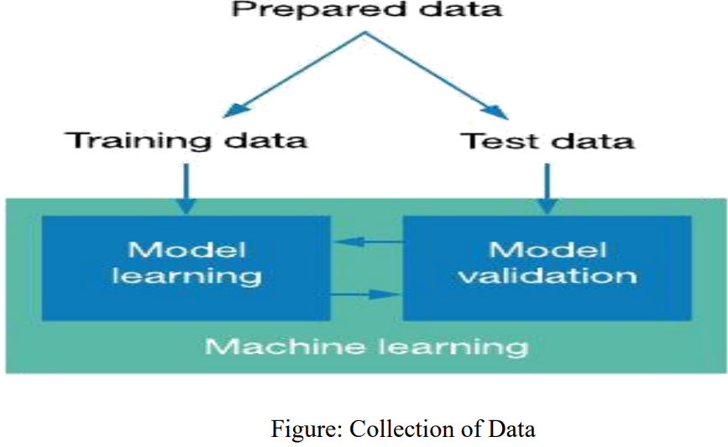
1 Collection of dataset:
Initially, we collect a dataset for our heart disease prediction system. After the collection of the dataset, we split the dataset into training data and testing data. The training dataset is used for prediction model learning and testing data is used for evaluating the prediction model. For this project, 70% of training data is used and 30% of data is used for testing. The dataset used for this project is Heart Disease UCI. The dataset consists of 76 attributes; out of which, 14 attributes are used for the system.

Slide 12
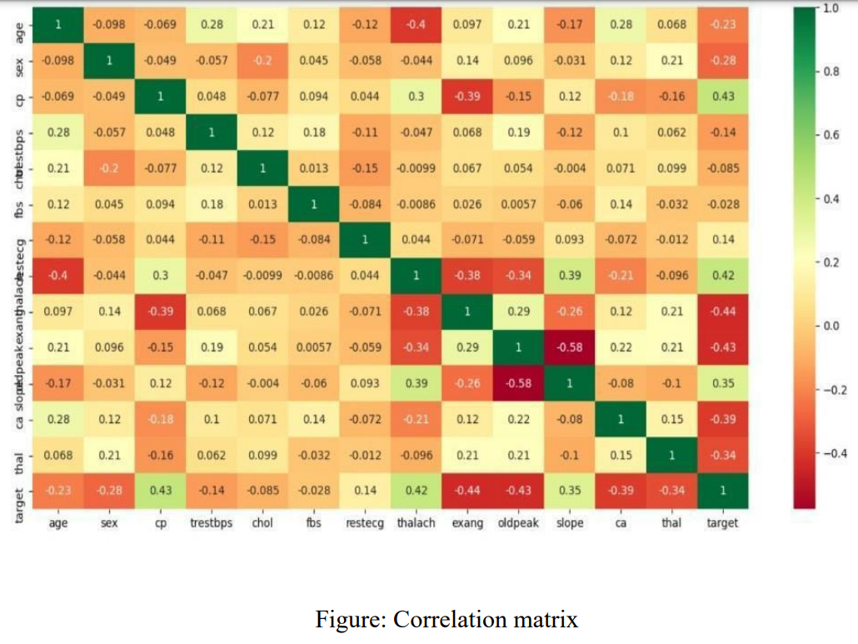
.2) Selection of attributes:
Attribute or Feature selection includes the selection of appropriate attributes for the prediction system. This is used to increase the efficiency of the system. Various attributes of the patient like gender, chest pain type, fasting blood pressure, serum cholesterol, exang, etc are selected for the prediction. The Correlation matrix is used for attribute selection for this model.

Slide 13
SELECTION OF THE ATTRIBUTES DATASET:
S.NO. | Attribute | Description | Type
1 | Age | Patient’s age (29 to 77) | Numerical
2 | Sex | Gender of patient(male-0 female-1) | Nominal
3 | Cp | Chest pain type | Nominal
4 | Trestbps | Resting blood pressure( in mm Hg on admission to hospital ,values from 94 to 200) | Numerical
5 | Chol | Serum cholesterol in mg/dl, values from 126 to 564) | Numerical
6 | Fbs | Fasting blood sugar>120 mg/dl, true- 1 false-0) | Nominal
7 | Resting | Resting electrocardio graphics result (0 to 1) | Nominal
8 | Thali | Maximum heart rate achieved(71 to 202) | Numerical
9 | Exang | Exercise included agina(1-yes 0- no) | Nominal
10 | Oldpeak | ST depression introduced by exercise relative to rest (0 to .2) | Numerical
11 | Slope | The slop of the peak exercise ST segment (0 to 1) | Nominal
12 | Ca | Number of major vessels (0-3) | Numerical
13 | Thal | 3-normal | Nomin

Slide 14
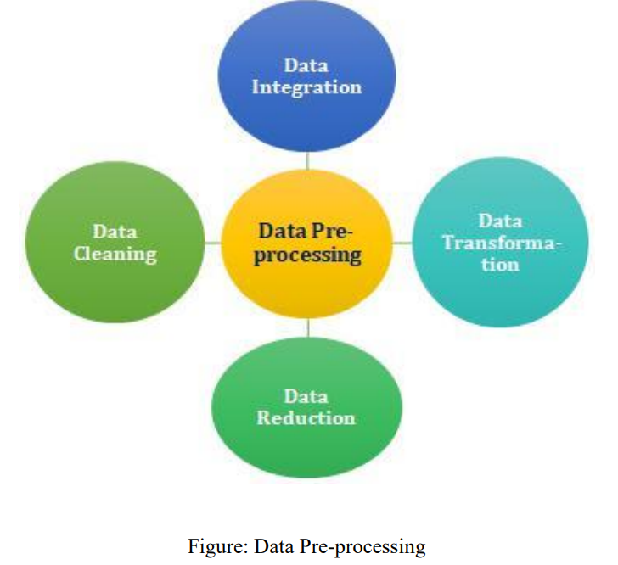
.3 )Pre-processing of Data:
Data pre-processing is an important step for the creation of a machine learning model. Initially, data may not be clean or in the required format for the model which can cause misleading outcomes. In pre-processing of data, we transform data into our required format. It is used to deal with noises, duplicates, and missing values of the dataset. Data pre-processing has the activities like importing datasets, splitting datasets, attribute scaling, etc. Preprocessing of data is required for improving the accuracy of the model.

Slide 15
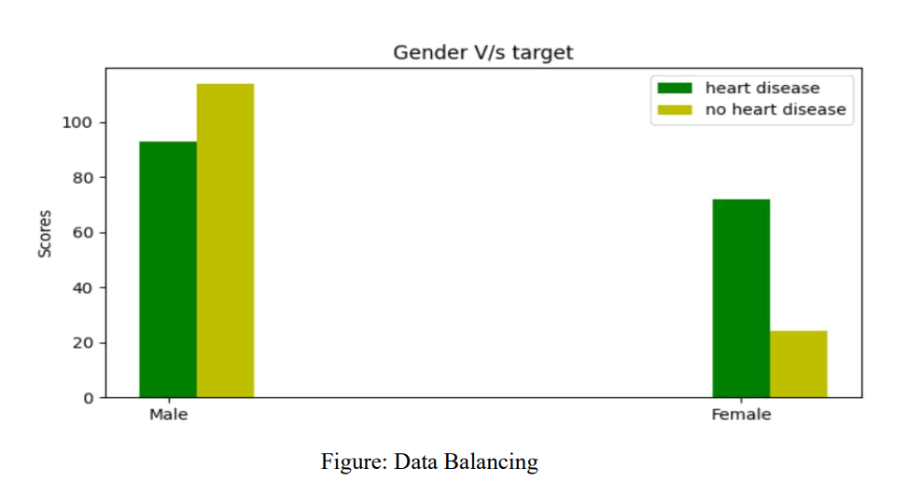
4) Balancing of Data:
Imbalanced datasets can be balanced in two ways. They are Under Sampling and Over Sampling
(a) Under Sampling: In Under Sampling, dataset balance is done by the reduction of the size of the ample class. This process is considered when the amount of data is adequate.
(b) Over Sampling: In Over Sampling, dataset balance is done by increasing the size of the scarce samples. This process is considered when the amount of data is inadequate.

Slide 16
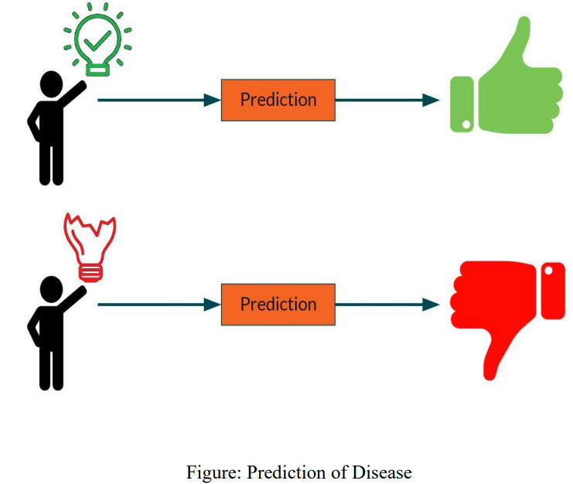
5) Prediction of Disease:
Various machine learning algorithms like SVM, Naive Bayes, Decision Tree, Random Tree, Logistic Regression, Ada-boost, Xg-boost are used for classification. Comparative analysis is performed among algorithms and the algorithm that gives the highest accuracy is used for heart disease prediction.

Slide 17
APPLICATION:
It utilizes the Data such as blood pressure, cholesterol, diabetes and then tries to predict the possible heart disease in patients (future Predication by diagnosis).
This may help in talking Preventive measure and hence can try to avoid the possibility of heart disease in patient.
So, When a patient is predicated as positive for heart disease, then the medical data for the patient can be analyzed by the doctors

Slide 18
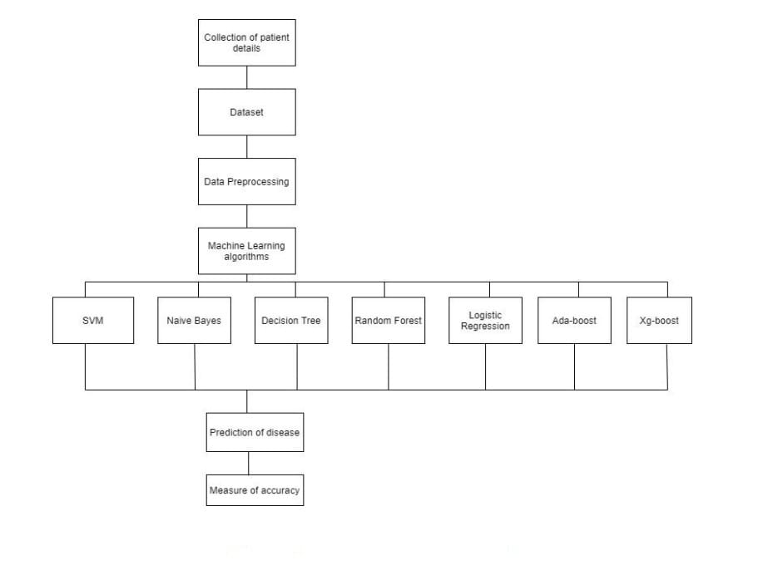
SYSTEM ARCHITECTURE:
The system architecture gives an overview of the working of the system.
The working of this system is described as follows:
Dataset collection is collecting data which contains patient details. Attributes selection process selects the useful attributes for the prediction of heart disease. After identifying the available data resources, they are further selected, cleaned, made into the desired form. Different classification techniques as stated will be applied on preprocessed data to predict the accuracy of heart disease. Accuracy measure compares the accuracy of different classifiers.

Slide 19
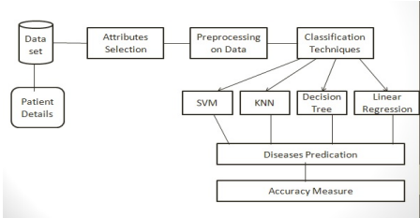
Architecture of Prediction System:

Slide 20

SYSTEM CONFIGURATION:
1 Hardware requirements:
• Processer : Any Update Processer
• Ram : Min 4GB
• Hard Disk : Min 100GB
2 Software requirements:
• Operating System : Windows family
• Technology : python 3.7
• IDE : Jupiter notebook

Slide 21
Machine Learning:
• Machine learning (ML) is a subset of artificial intelligence (AI). It uses statistical techniques to enable computers to learn and make decisions without being explicitly programmed.
• ML allows machines to automatically learn from data and past experiences to identify patterns and make predictions with minimal human intervention. For example, personal voice assistants like Siri, Alexa, and Cortana use ML-based speech recognition.
• ML is also used in social media.
• Types of machine Learning
• 1) Supervised Machine Learning.
• 2) Unsupervised Machine Learning.
• 3) Reinforcement machine Learning

Slide 22
1) Supervised MACHINE Learning :
Supervised machine learning is a type of machine learning that uses labeled data to train algorithms to classify data or predict outcomes.In supervised learning, the training data provided to the machines work as the supervisor that teaches the machines to predict the output correctly. It applies the same concept as a student learns in the supervision of the teacher. Supervised learning is a process of providing input data as well as correct output data to the machine learning model. The aim of a supervised learning algorithm is to find a mapping function to map the input variable(x) with the output variable(y).

Slide 23
2)UNSUPERVISED MACHINE LEARNING:
• Unsupervised machine learning is a machine learning technique that uses algorithms to find patterns in unlabeled data. Because Unsupervised learning cannot be directly applied to a regression or classification problem because unlike supervised learning, we have the input data but no corresponding output data. The goal of unsupervised learning is to find the underlying structure of dataset, group that data according to similarities, and represent that dataset in a compressed format.
• Unsupervised learning is helpful for finding useful insights from the data.
• Unsupervised learning is much similar to how a human learns to think by their own experiences, which makes it closer to the real AI.
• In real-world, we do not always have input data with the corresponding output so to solve such cases, we need unsupervised learning.

Slide 24

3)REINFORCEMENT MACHINE LEARNING:
• Reinforcement learning is an area of Machine Learning. It is about taking suitable action to maximize reward in a particular situation. It is employed by various software and machines to find the best possible behavior or path it should take in a specific situation.

Slide 25
MACHINE LEARNING ALGORITHMS:
• In this work, Eleven machine leaning algorithms which include
1) Random Forest
2) SVM
3) Decision Tree
4) Naïve Bayes
5) ANN
7) KNN
8) Logistic Regression
9) Linear Regression
10) Ada-boost
11) Xg-boost
These algorithms are used to unfold a prediction system which will analyze and predict whether the particular patient is pertaining to any heart disease or not with best accuracy.
6) DNN

Slide 26
1) Support Vector Machine:
• Support Vector Machine or SVM is one of the most popular Supervised Learning algorithms, which is used for Classification as well as Regression problems. However, primarily, it is used for Classification problems in Machine Learning.
• The main objective of the SVM algorithm is to find the optimal hyperplane in an N-dimensional space that can separate data points into different classes. The hyperplane tries to maximize the margin between the closest points of different classes. The optimal divider is the one that is equidistant from the boundaries of each group.
• SVMs were first introduced in the 1960s and refined in 1990. They are broadly classified into two types: simple or linear SVM and kernel or non-linear SVM
• To train and test a SVM model, the data is divided into train and test data. The data is also scaled to lie between 0 and 1

Slide 27
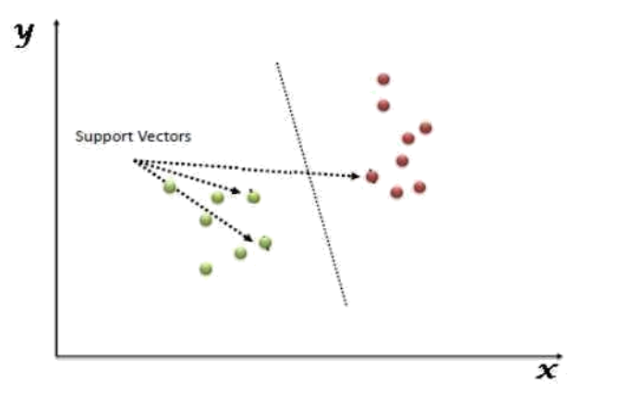
The followings are important concepts in SVM:
1) Support Vectors - Data Points that are closest to the hyperplane are called support vectors. Separating line will be defined with the help of these data points.
2) Hyperplane - As we can see in the above diagram, it is a decision plane or space which is divided between a set of objects having different classes.
3) Margin - It may be defined as the gap between two lines on the closest data points of different classes. It can be calculated as the perpendicular distance from the line to the support vectors. Large margin is considered as a good margin and small margin is considered as a bad margin.

Slide 28
Advantages And Disadvantages of support vector machines:
ADVANTAGES:
● Effective in high dimensional spaces.
● Still effective in cases where the number of dimensions is greater than the number of samples.
● Uses a subset of training points in the decision function (called support vectors), so it is also memory efficient.
DISADVANTAGES:
● If the number of features is much greater than the number of samples, avoid over-fitting in choosing Kernel functions and regularization term is crucial. SVMs do not directly provide probability estimates, these are calculated using an expensive five-fold cross-validation.

Slide 29
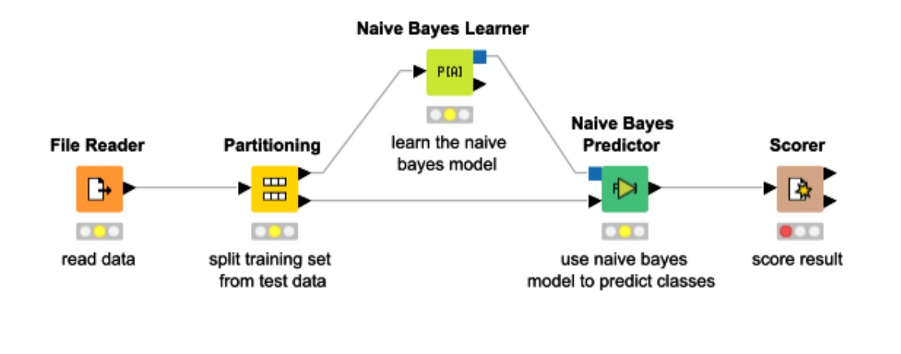
2) NAIVE BAYES ALGORITHM:
It is a machine learning technique that works on the strategy of the Bayes’ Theorem. It basically assumes that there would be no attributes dependent on each other. It is a group of algorithms that have a common principle that every feature is independent of the other. Bayes’ Theorem tells us the probability of an event that will occur when another event has already occurred. The mathematical equation is:
• Probability(a|z) = (Probability(z|a) * Probability(a)) / Probability(z)
• Where :
• Probability(a|z): Gives us the probability of a (the hypothesis) gives the data is a.
• Probability (z|a): Gives the probability of the data when the hypothesis is true.
• Probability (a): Regardless of the data, the hypothesis is said to be true.
• Probability (d): Regardless if the data, the probability of the hypothesis is given.

Slide 30
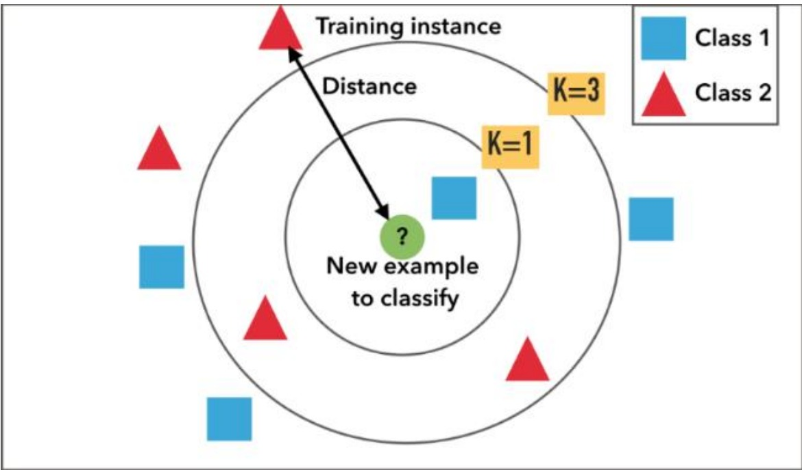
3) KNN:
• K nearest neighbors abbreviated as KNN is an algorithm that clusters data into classes and then classifies it as per their similarity measures. Classification is based on the majority of the votes to its neighbors. Data is assigned to the classes that have the nearest neighbors. As we increase the number of nearest neighbors, I.e. the value of k, the accuracy might increase. KNN is broadly used for pattern recognition and statistical prediction.
• It divides the data into clusters, based upon the distance from the nearest neighbor.

Slide 31
4) Decision Tree :
• Decision Tree is one of the supervised learning algorithms. In this the data is continuously split based on a certain parameter after which we end up getting the decision nodes and the leaves. What makes it different from the other supervised algorithms is that is can also solve the regression and classification problems easily. The main aim is to create a system that can predict the results that we desire just by learning the decision rules from the prior data, i.e., the training set.

Slide 32
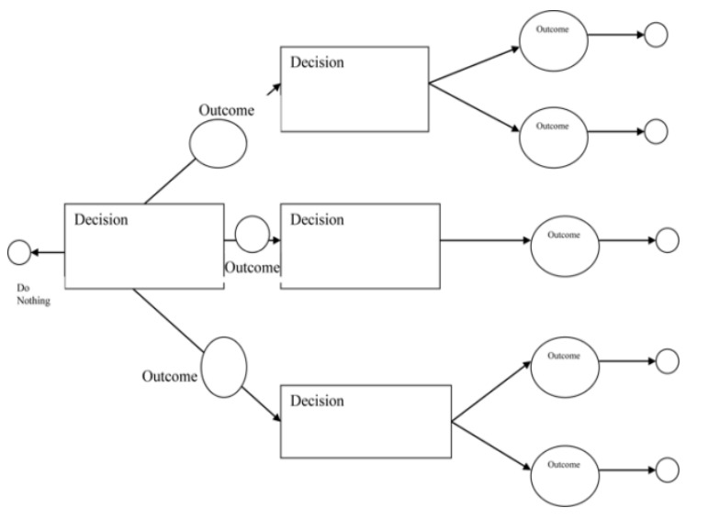
Working:
In a Decision Tree, for predicting the class of the given dataset, the algorithm starts from the root node of the tree. This algorithm compares the values of the root attribute with the record (real dataset) attribute and based on the comparison, follows the branch and jumps to the next node. For the next node, the algorithm again compares the attribute value with the other sub-nodes and moves further. It continues the process until it reaches the leaf node of the tree. The complete process can be better understood using the below algorithm:
● Step-1: Begin the tree with the root node, says S, which contains the complete dataset.
● Step-2: Find the best attribute in the dataset using Attribute Selection Measure (ASM).
● Step-3: Divide the S into subsets that contains possible values for the best attributes.
● Step-4: Generate the Decision Tree node, which contains the best attribute.
● Step-5: Recursively make new decision trees using the subsets of the dataset created in step -3. Continue this process until a stage is reached where you cannot further classify the nodes and call the final node as a leaf node.

Slide 33
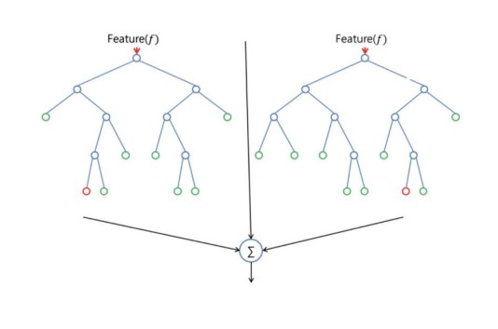
5) Random forest:
• Random Forest, just as the name suggest creates a number of random forest due to which it is also called the random decision forest. It is one of the supervised learning algorithms. It builds random forests that are basically just a group of decision trees. It is mostly trained with the bagging method as it is the most efficient. What the bagging method does is, it combines all the learning models which in turn helps us with the overall result. Just like decision trees, it can be used for both, regression and classification problems

Slide 34
Algorithm Steps:
It works in four steps:
● Select random samples from a given dataset.
● Construct a Decision Tree for each sample and get a prediction result from each Decision Tree.
● Perform a vote for each predicted result.
● Select the prediction result with the most votes as the final prediction.

Slide 35
Advantages And Disadvantages:
ADVANTAGES:
● Random Forest is capable of performing both Classification and Regression tasks.
● It is capable of handling large datasets with high dimensionality.
● It enhances the accuracy of the model and prevents the overfitting issue.
DISADVANTAGES:
Although Random Forest can be used for both classification and regression tasks, it is not more suitable for Regression tasks.

Slide 36
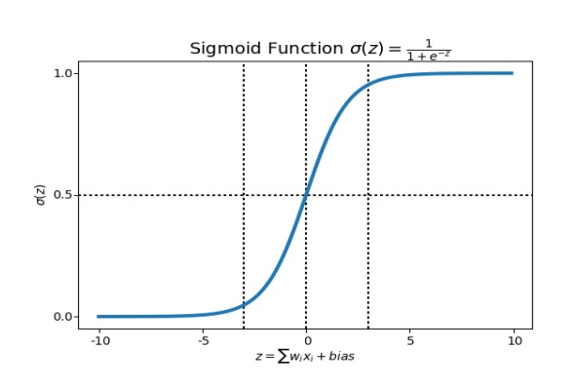
6) Logistic Regression:
• Logistic Regression is rather a predictive analysis. It is used to analyze the relation between the data among which one is a dependent variable and the other one is independent. What logistic regression does is, it rounds off all the values of the results to the closest binary value for the ease of prediction. This can sometimes cause a few errors, and not predict very precisely. In order to remove this error, multiple regression is used which helps in getting the closest to the true result. Logistic Regression uses complex cost functions such as the ‘Sigmoid function’. In machine learning sigmoid is used to predict the probabilities.

Slide 37
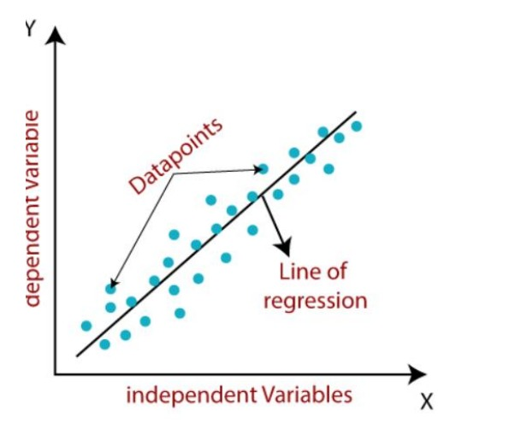
7) Linear Regression:
• Linear regression is a fundamental machine learning algorithm used for predicting numerical values based on input features. It assumes a linear relationship between the features and the target variable. The model learns the coefficients that best fit the data and can make predictions for new inputs.
• Linear regression algorithm shows a linear relationship between a dependent (y) and one or more independent (y) variables, hence called as linear regression. Since linear regression shows the linear relationship, which means it finds how the value of the dependent variable is changing according to the value of the independent variable.
• The linear regression model provides a sloped straight line representing the relationship between the variables. Consider the below image:
Y= Dependent Variable (Target Variable) X= Independent Variable (predictor Variable)

Slide 38
8) Artificial Neural Network (ANN):
An artificial neural network abbreviated as ANN is a model that works as the human brain or neural network I.e. the neurons. It is called a computational model that processes all the complex data. It isn’t given any task specific goal, but it learns from the examples or data that is given to it just like the brain. It is based on a collection of nodes called the artificial neuron. More the no. Of neurons, better the system. The neurons transmit signals from one to another making a proper connection which resembles the human neural network.
A neural network has the following 3 layers:

Slide 39
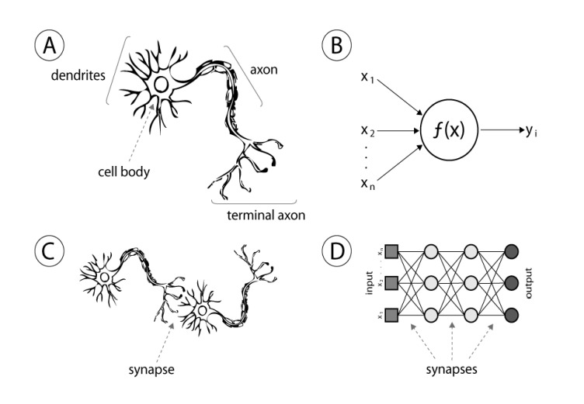
3 layers:
• Input layer – It consists of the complex raw info that we feed to the neurons.
• Hidden layer – These are the computational layers which take the input and the weight of a node from the previous layers, processes it with the activation function, and sends the output to the next layer.
• Output layer – This depends of the output of the hidden layers, and the functions taking place in there.
# The basic computational unit is the neuron. It receives inputs from the sources provided, and each input carries a weight, which is given according to the relative importance of all the other inputs. Then the function is applied to

Slide 40
9) DEEP NEURAL NETWORK:
Deep Neural Network abbreviated as DNN, is a complex neural network consisting of more than 2 layers. This algorithm uses high level mathematical models for data processing in complex manner. Deep learning is derived from a vaster family of networks of neural methods, such as CNNs. Deep learning can either be unsupervised, supervised or semi- supervised.
Deep, Convolutional and recurrent neural networks are utilized in natural language processing, computer vision, audio recognition, recognition, social network filtering, bioinformatics, machine translation, image analysis, drug design, and material inspection, where the outcomes were comparable/superior to some human professionals.

Slide 41
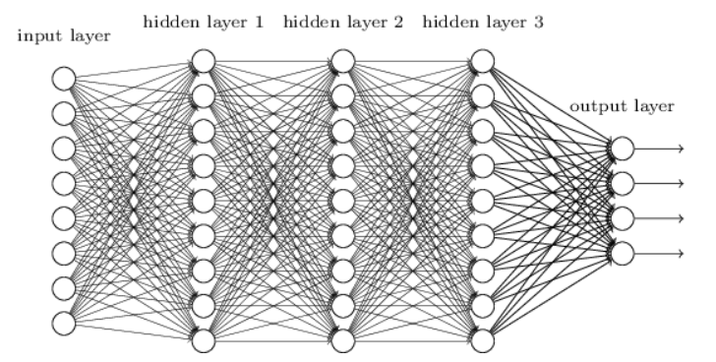
Deep Neural Networks:
• Use different layers of nonlinear units of processing for featured extraction as well as transformation. Each of the successive layers uses the previous layer’s output as the input.
• Can either be supervised, unsupervised or semi-supervised
• learn different hierarchies of representations which relate to different hierarchies of abstractions.
• It consists of an input layer, an output layer and between many variable hidden layers.
• Output of one layer goes as the input to other. The activation function used in our module is the ReLU between hidden layers and Softmax at the output layer which takes 0 or 1 .

Slide 42
10) ADABOOST ALGORITHM:
• Ada-boost was the first really successful boosting algorithm developed for the purpose of binary classification. Adaboost is short for Adaptive Boosting and is a very popular boosting technique which combines multiple “weak classifiers” into a single “strong classifier”
• ALGORITHM:
• 1. Initially, Adaboost selects a training subset randomly.
• 2. It iteratively trains the Adaboost machine learning model by selecting the training set based on the accurate prediction of the last training.
• 3. It assigns the higher weight to wrong classified observations so that in the next iteration these observations will get the high probability for classification.
• 4. Also, it assigns the weight to the trained classifier in each iteration according to the accuracy of the classifier. The more accurate classifier will get high weight.
• 5. This process iterates until the complete training data fits without any error or until reached to the specified maximum number of estimators.
• 6. To classify, perform a "vote" across all of the learning algorithms you built

Slide 43
Advantages And Disadvantages:
Advantages:
• It's easy to implement
• It can be used with any dataset
• It's less prone to overfitting than other algorithms
• It can improve the accuracy of weak classifiers
• It can be used with many base classifiers
• It's easier to use than other algorithms
• It can be used to classify text and images
• Disadvantages:
• AdaBoost uses a progressively learning boosting technique. Hence high-quality data is needed in examples of AdaBoost vs Random Forest. It is also very sensitive to outliers and noise in data requiring the elimination of these factors before using the data.

Slide 44
11) XGBOOST ALGORITHM:
• XG-Boost is a robust machine-learning algorithm that can help you understand your data and make better decisions. XG-Boost is an implementation of gradient-boosting decision trees.
• XG-boost is an implementation of Gradient Boosted decision trees. It is a type of Software library that was designed basically to improve speed and model performance. In this algorithm, decision trees are created in sequential form. Weights play an important role in XG-boost. Weights are assigned to all the independent variables which are then fed into the decision tree which predicts results. Weight of variables predicted wrong by the tree is increased and these the variables are then fed to the second decision tree. These individual classifiers/predictors then assemble to give a strong and more precise model. It can work on regression, classification, ranking, and user-defined predict.

Slide 45
1) Regularization:
• Regularization: XG-Boost incorporates regularization techniques to prevent overfitting. It includes both L1 and L2 regularization terms in its objective function, which helps in controlling the complexity of the model and reducing variance.
• gamma: The minimum loss reduction allowed for a split to occur. The optimal value of gamma depends on the data set and other parameter values.
• alpha: L1 regularization on leaf weights. Larger values mean more regularization.
• lambda: L2 regularization. This term is a constant that is added to the second derivative (Hessian) of the loss function during gain and weight (prediction) calculations.
• The regularization term (Ω) is a combination of L1 and L2 regularization terms. It is defined as:
• Ω(F) = λ * Ω1(F) + 0.5 * γ * Ω2(F)
• WHERE:
• Ω1(F) is the L1 norm of the leaf weights
• Ω2(F) is the L2 norm of the leaf weights
• Regularization parameters usually impact tree structure as well as weight values

Slide 46
2) Parallel processing:
• Parallelization – The process of sequential tree building is done using the parallelized implementation in the XGBoost algorithm. This is made possible due to the outer and inner loops that are interchangeable. The outer loop lists the leaf nodes of a tree, while the inner loop will calculate the features.
• : XG-boost utilizes the power of parallel processing and that is why it is much faster than GBM. It uses multiple CPU cores to execute the model. While using Scikit Learn libarary, nthread hyper-parameter is used for parallel processing. nthread represents number of CPU cores to be used. If you want to use all the available cores, don't mention any value for nthread and the algorithm will detect automatically.

Slide 47
3) Handling missing values:
• XG-boost has an in-built capability to handle missing values. When XG-boost encounters a missing value at a node, it tries both the left and right hand split and learns the way leading to higher loss for each node. It then does the same when working on the testing data.
4) Cross Validation: XG-boost allows user to run a cross-validation at each iteration of the boosting process and thus it is easy to get the exact optimum number of boosting iterations in a single run. This is unlike GBM where we have to run a grid-search and only a limited values can be tested.

Slide 48
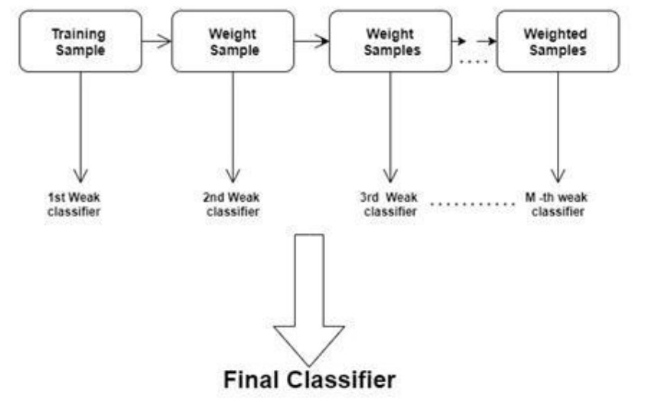
5) Effective Tree Pruning:
• Tree Pruning: XG-Boost uses max-depth parameter as specified the stopping criteria for the splitting of the branch and starts pruning trees backward. This depth-first approach improves computational performance significantly.
• A GBM would stop splitting a node when it encounters a negative loss in the split. Thus, it is more of a greedy algorithm. XG-boost on the other hand make splits up to the max-depth specified and then start pruning the tree backwards and remove splits beyond which there is no positive gain.

Slide 49
Predication of Disease:
• Disease Prediction is a Machine Learning based system which primarily works according to the symptoms given by a user. The disease is predicted using algorithms and comparison of the datasets with the symptoms provided by the user.
• Machine learning (ML) can predict diseases by using algorithms to compare a user's symptoms with datasets. The system takes the user's symptoms as input and outputs the probability of the disease.
• Some machine learning algorithms used for disease prediction include:
• Naïve Bayes classifier: A supervised machine learning algorithm that calculates the probability of the disease
• Random forest classifier: Used to predict disease likelihood
• Support vector machine: A supervised learning algorithm
• Logistic regression: A supervised learning algorithm
• Artificial neural network: A supervised learning algorithm

Slide 50
DATA SET DETAILS :
For eg: Our system here, uses a dataset to predict the occurrence of heart diseases by dividing the dataset into test data and training data. 70% data is used for training and the rest 30% is used for testing. Now, the input used in our case is the attributes we have used that correspond to factors that result in heart diseases. The output would be a binary digit indicating whether a person is susceptible to heart diseases or not. The algorithms used in the system for prediction, are learning algorithms which will always change over periods of time based on various input factors . Therefore, the results might change when we learn even more about the data fed as input.
https://github.com/Abhayku18113211/Heart-Disease-Prediction-System-Using-ML

Slide 51
Data set used:
For our system, we have taken dataset that was publicly available on Kaggle for predicting the heart diseases. The parameters used as input for data analysis using Machine learning algorithm are as follows:
1. age: which is taken in years
2. sex: 1 for male, 0 for female
3. cp: short for chest pain
4. Trestbps : blood pressure taken when the body is resting
5. Chol : level of cholesterol
6. fasting blood sugar: (1 for true; 0 for false)
7. resting electrocardiographic results Value 0: normal Value 1: having the ST-T wave which is not normal Value 2: shows the probability of having left ventricular hypertrophy
8. Thalach: the max level of heartbeats achieved by heart
9. Exercise induced angina: 1 for yes, 0 for no
10. Oldpeak: the depression by exercise compared to the one at rest
11. slope: peak of the ST segment during exercise
Value 1: no slope
Value 2: straight line
Value 3: down sloping
12. ca: major vessels (0-3) colored by fluoroscopy
13. Thal: 3= perfect; 6=permanently defected; 7=defect can be altered 14. num: heart disease diagnoses

Slide 52
Measure of Accuracy (Performance Analysis):
• In this project, various machine learning algorithms like SVM, Naive Bayes, Decision Tree, Random Forest, Logistic Regression, Ada-boost Xg-boost are used to predict heart disease. Heart Disease UCI dataset, has a total of 76 attributes, out of those only 14 attributes are considered for the prediction of heart disease. Various attributes of the patient like gender, chest pain type, fasting blood pressure, serum cholesterol, Exang etc. are considered for this project. The accuracy for individual algorithms has to measure and whichever algorithm is giving the best accuracy that is considered for the heart disease prediction. For evaluating the experiment, various evaluation metrics like accuracy, confusion matrix, precision, recall, and f1-score are considered.
Accuracy- Accuracy is the ratio of the number of correct predictions to the total number of inputs in the dataset.
• 1) The accuracy rate of each algorithm has been measured and selects the algorithm with the highest accuracy. The accuracy rate is a correct prediction ratio to the total number of given datasets. It is expressed as:
• Accuracy = (TP + TN) /(TP+FP+FN+TN)
• Where:
• TP: True Positive
• TN: True Negative
• FP: False Positive
• FN: False Negative

Slide 53
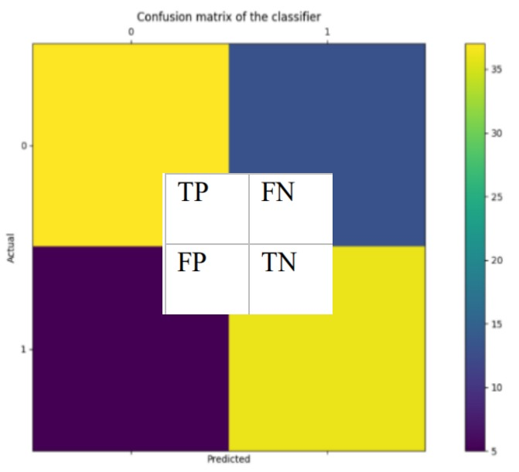
1)Confusion Matrix:
• It gives us a matrix as output and gives the total performance of the S system.
• It is a binary classifier. A confusion matrix can be of any size depending upon the different number of parameters inputted (labels in our case).
• Where:
• TP: True positive
• FP: False Positive
• FN: False Negative
• TN: True Negative
• The numerical value of TP, FP, TN, FN defines as:
• TP= occur when the model accurately predicts a positive data point.
• TN= occur when the model accurately predicts a negative data point.
FP= occur when the model predicts a positive data point incorrectly.
FN= occur when the model mispredicts a negative data point.

Slide 54
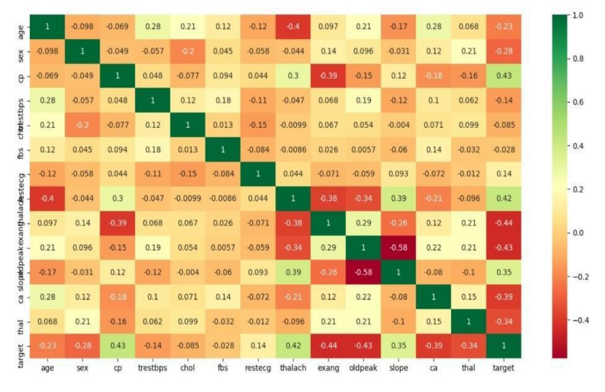
2) Correlation Matrix:
The correlation matrix in machine learning is used for feature selection. It represents dependency between various attributes. Selection of attributes: Attribute or Feature selection includes the selection of appropriate attributes for the prediction system. This is used to increase the efficiency of the system. Various attributes of the patient like gender, chest pain type, fasting blood pressure, serum cholesterol, exang etc are selected for the prediction. The Correlation matrix is used for attribute selection for this model.

Slide 55
3) Precision:
• - It is the ratio of correct positive results to the total number of positive results predicted by the system.
• 𝑃𝑟𝑒𝑐𝑖𝑠𝑖𝑜𝑛 = 𝑇𝑃/(𝑇𝑃 + 𝐹𝑃)
• It is expressed as:
• 4) Recall-
It is the ratio of correct positive results to the total number of positive results predicted by the system.
• 𝑅𝑒𝑐𝑎𝑙𝑙 = 𝑇𝑃/(𝑇𝑃 + 𝐹𝑁)
• 5) F1 score-:
This metric takes into recall and precision and is calculated as below
It is the harmonic mean of Precision and Recall. It measures the test accuracy. The range of this metric is 0 to 1. It is expressed as:
𝐹1 𝑠𝑐𝑜𝑟𝑒 = 2 ∗ (𝑃𝑟𝑒𝑐𝑖𝑠𝑖𝑜𝑛 ∗ 𝑅𝑒𝑐𝑎𝑙𝑙)/(𝑃𝑟𝑒𝑐𝑖𝑠𝑖𝑜𝑛 + 𝑅𝑒𝑐𝑎𝑙𝑙)

Slide 56
Example Of Confusion Matrix For Measure Accuracy (Performance Analysis):
A 2X2 Confusion matrix is shown below for the image recognition having a Heart Patient image or Not Heart Patient image.
INDEX | 1 | 2 | 3 | 4 | 5 | 6 | 7 | 8 | 9 | 10
Actual | Patient | Patient | Patient | Not Patient | Patient | Not Patient | Patient | Patient | Not Patient | Not Patient
Predicted | Patient | Not Patient | Patient | Not Patient | Patient | Patient | Patient | Patient | Not Patient | Not Patient
Result | TP | FN | TP | TN | TP | FP | TP | TP | TN | TN
Actual Patient Counts = 6
Actual Not Patient Counts = 4
True Positive Counts = 5
False Positive Counts = 1
True Negative Counts = 3
False Negative Counts = 1

Slide 57
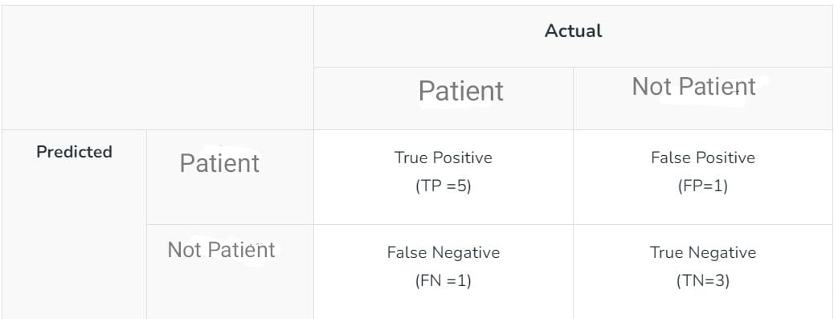
Metrics based on Confusion Matrix Data:
2. Precision
2) Precision : is a measure of how accurate a model’s positive predictions are. It is defined as the ratio of true positive predictions to the total number of positive predictions made by the model.
𝑇𝑃/(𝑇𝑃 + 𝐹𝑃)
For the above case: Precision = 5/(5+1) =5/6 = 0.8333
1. Accuracy
Accuracy is used to measure the performance of the model. It is the ratio of Total correct instances to the total instances.
Accuracy = (TP + TN) /(TP+FP+FN+TN)
For the above case:
Accuracy = (5+3)/(5+3+1+1) = 8/10 = 0.8

Slide 58
3. Recall
It is the ratio of correct positive results to the total number of positive results predicted by the system.
• 𝑅𝑒𝑐𝑎𝑙𝑙 = 𝑇𝑃/(𝑇𝑃 + 𝐹𝑁)
For the above case:
Recall = 5/(5+1) =5/6 = 0.8333
4. F1-Score :
F1 – Score is used to evaluate the overall performance of a classification model. It is the harmonic mean of precision and recall,
𝐹1 𝑠𝑐𝑜𝑟𝑒 = 2 ∗ (𝑃𝑟𝑒𝑐𝑖𝑠𝑖𝑜𝑛 ∗ 𝑅𝑒𝑐𝑎𝑙𝑙)/(𝑃𝑟𝑒𝑐𝑖𝑠𝑖𝑜𝑛 + 𝑅𝑒𝑐𝑎𝑙𝑙)
For the above case:
F1-Score: = (2* 0.8333* 0.8333)/( 0.8333+ 0.8333) = 0.8333

Slide 59
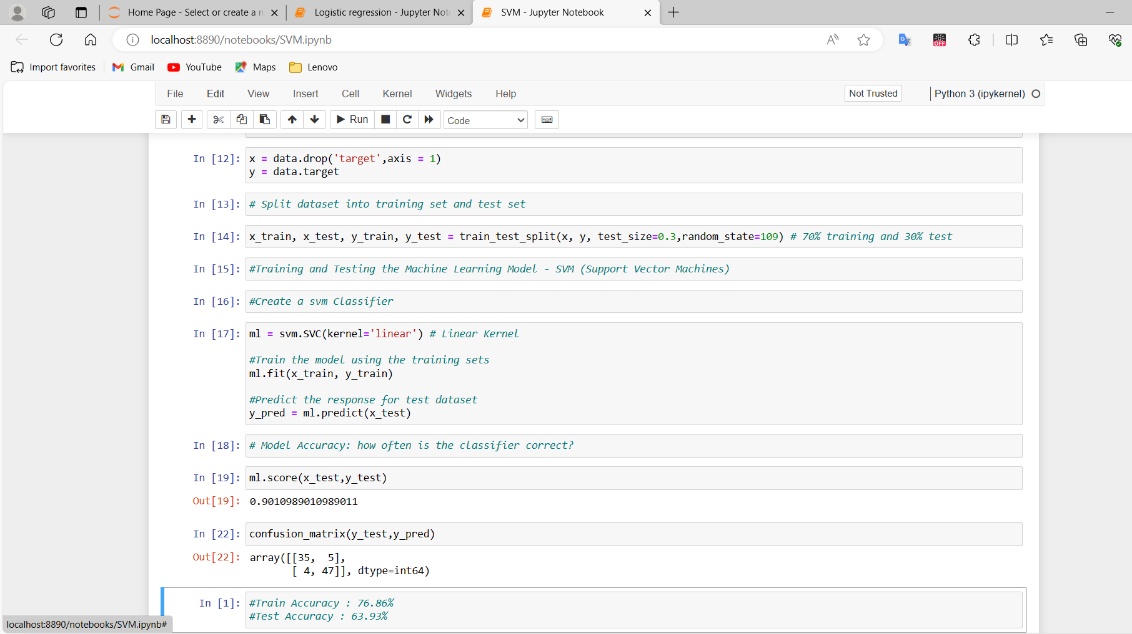
PERFORMANCE OF MACHINE LEARNING ALGORITHMS :SVM
Accuracy : 0.901
Precision : 0.904
Recall : 0.922
Fi Score : 0.909
 |  | Actual Value | Actual Value
 |  | Positive | Negative
Predicated Value |  | TP: 47 | TN:35
Predicated Value |  | FP:5 | FN:4

Slide 60
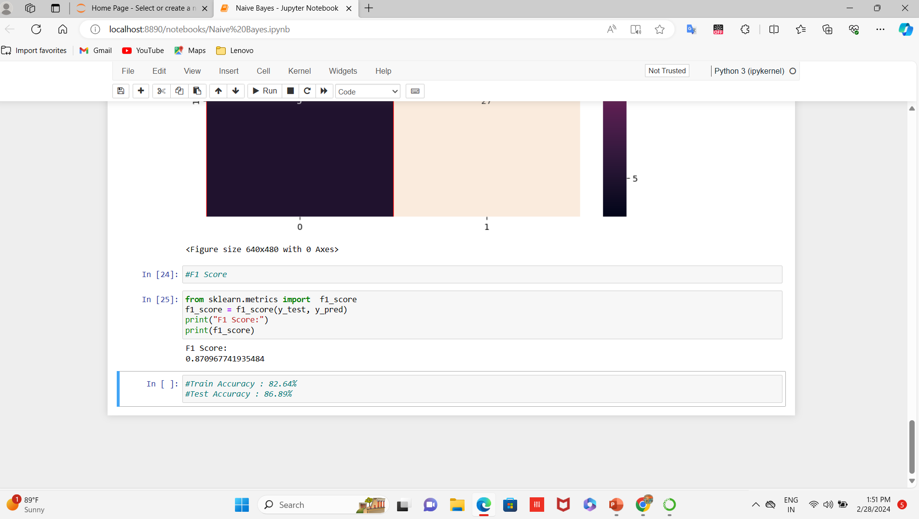
Naïve Bayes Results:
Accuracy : 0.869
Precision: 0.900
Recall : 0.844
F1 Score : 0.871
 |  | Actual Value | Actual Value
 |  | Positive | Negative
Predicated Values | True | TP: 27 | FN: 26
Predicated Values | False | FP: 3 | TN: 5

Slide 61
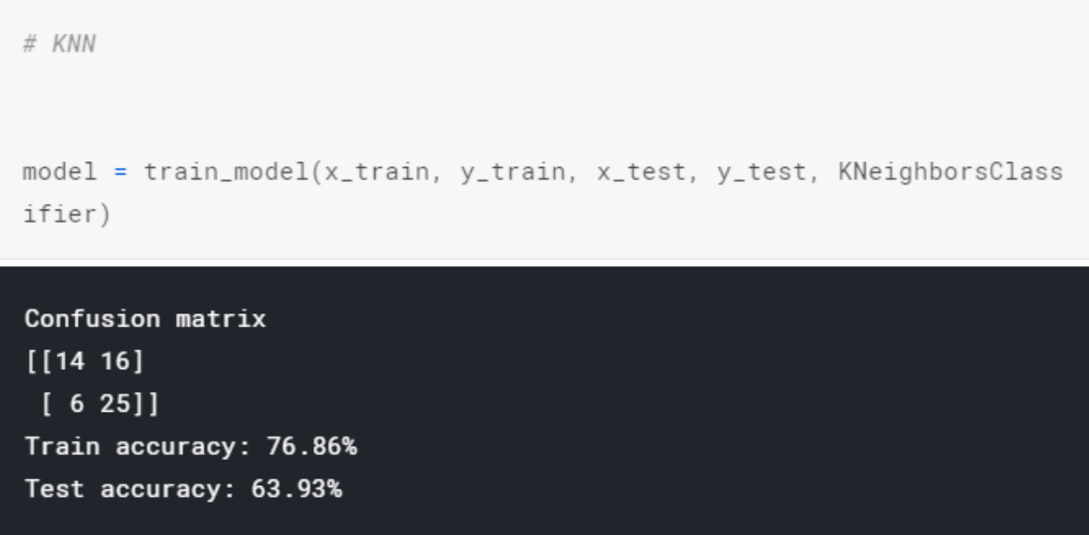
KNN RESULTS:
Accuracy : 0.639
Precision : 0.4666
Recall : 0.76
F1 Score :
 |  | Actual Value | Actual Value
 |  | Positive | Negative
Predicated Value | True | TP:14 | FN:16
Predicated Value | False | FP:6 | TN:25

Slide 62
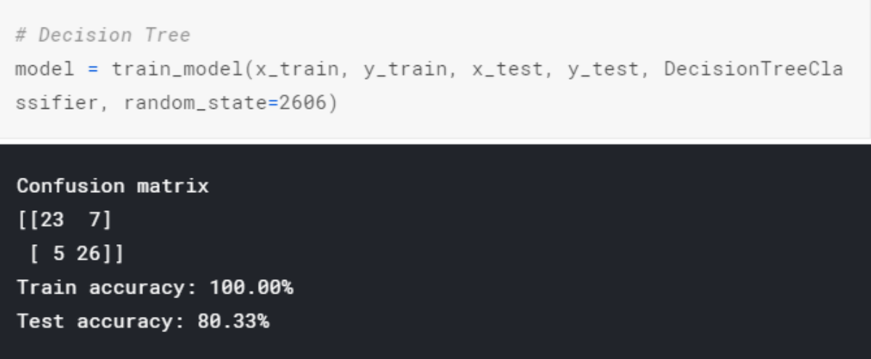
DECISION TREE RESULTS:
ACCURACY: 0.8033
RECALL: 0.7666
PRECISION: 0.821
F1 Score : 0.271
 |  | Actual Value | Actual Value
 |  | Positive | Negative
Predicated Values | True | TP: 23 | TN: 7
Predicated Values | False | FP: 5 | FN: 26

Slide 63
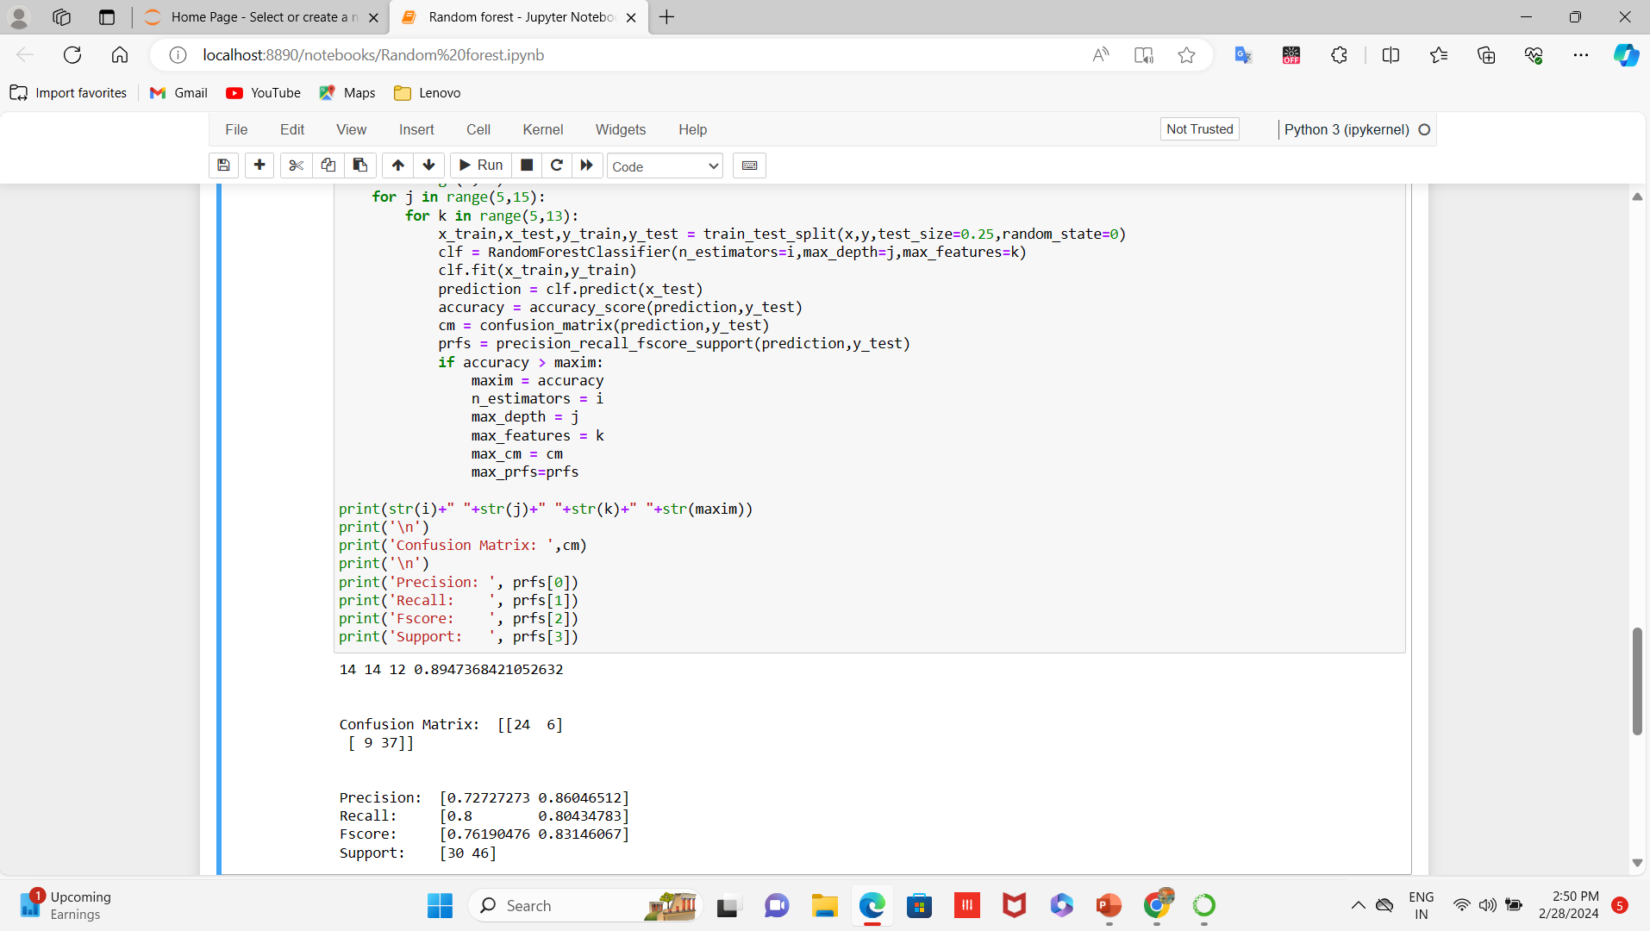
RANDOM FOREST RESULTS:
ACCURACY: 0.803
RECALL:0.8 04 F1Score 0.832
PRECISION:0.860
 |  | Actual Value | Actual Value
 |  | Positive | Negative
Predicated Values | True | TP:24 | TN:6
Predicated Values | False | FP:9 | FN:37

Slide 64
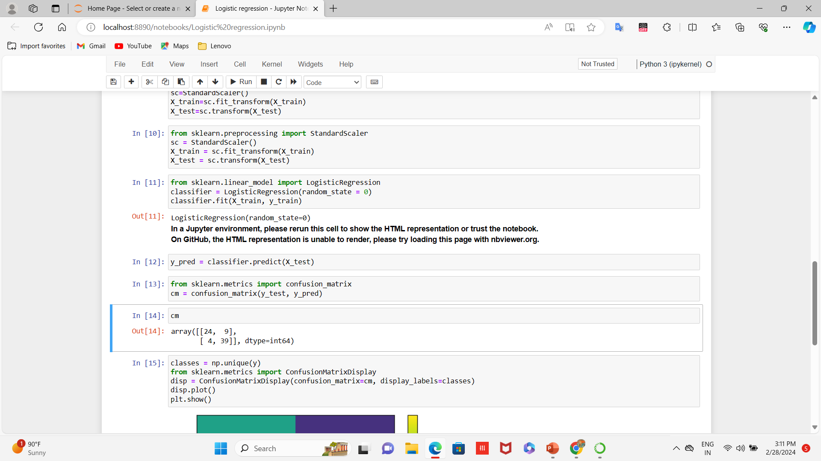
LOGISTIC REGRESSION RESULTS:
ACCURACY: 0.829
RECALL:0.907
PRECISION:0.813
F1 Score: 0.856
 |  | Actual Value | Actual Value
 |  | Positive | Negative
Predicated Value | TRUE | TP:24 | TN:9
Predicated Value | FALSE | FP:4 | FN:39

Slide 65
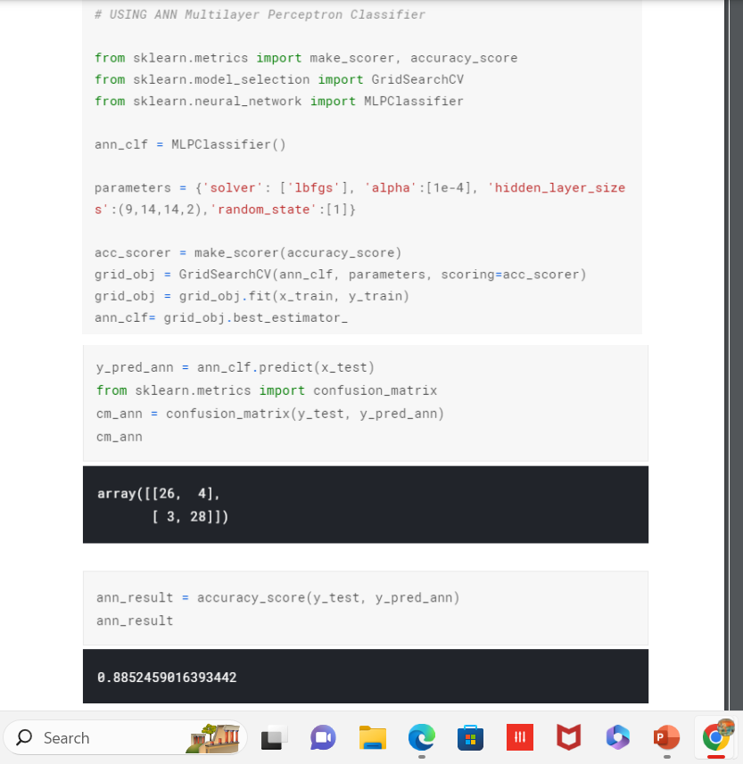
ANN RESULTS:
ACCURACY: 0.8852
RECALL: 0.8666
PRECISION:0.8965
F1 Score:0.84699
 |  | Actual Value | Actual Value
 |  | Positive | Negative
Predicated Values | True | TP:26 | TN:4
Predicated Values | False | FP:3 | FN:28

Slide 66
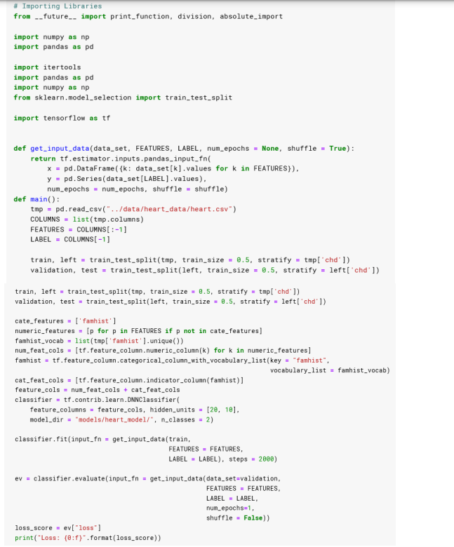
DNN RESULTS:
ACCURACY: 0.918
RECALL: 0.9033
PRECISION: 0.9655
F1 Score:0.5320
 |  | Actual Value | Actual Value
 |  | Positive | Negative
Predicated Values | True | TP:28 | FN:3
Predicated Values | False | FP:1 | TN:28

Slide 67
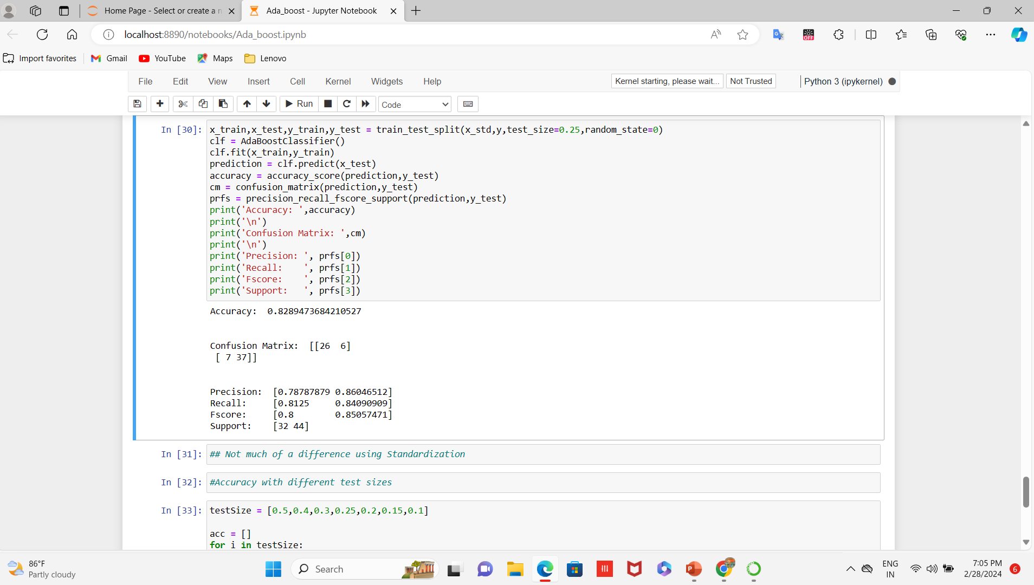
ADA-BOOST RESULTS:
Accuracy:0.829
Precision:0.860
Recall:0.841
F1 Score:0.849
 |  | Actual Value | Actual Value
 |  | Positive | Negative
Predicated Values | True | TP:26 | FN:6
Predicated Values | False | FP:7 | TN:37

Slide 68
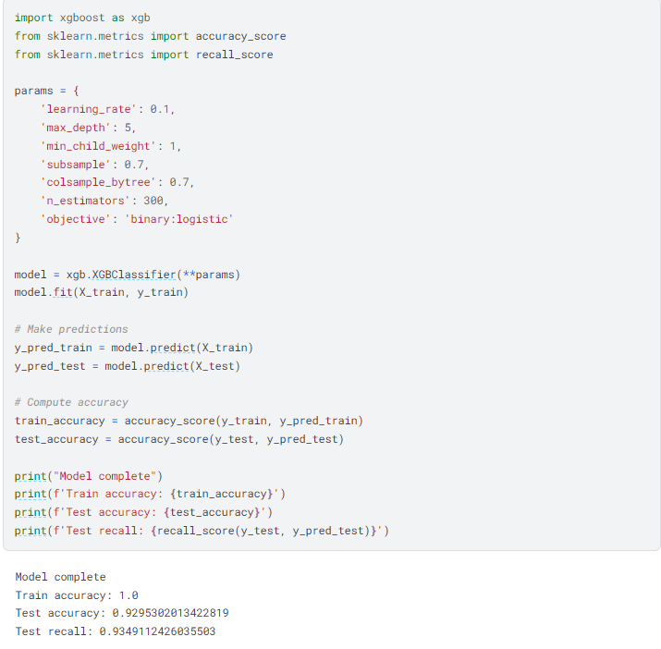
XG-BOOST RESULTS:
Accuracy: 0.918
Precision:0.960
Recall:0.857
F1 Score:0.905
 |  | Actual Value | Actual Value
 |  | Positive | Negative
Predicated Values | True | TP:32 | FN:1
Predicated Values | False | FP:4 | TN:24

Slide 69
COADING AND TESTING:
1) Software Requirement:
1. Anaconda : It is an open-source software available to us which enables us to easily code in using python or R on different operating systems such as the windows, Linux, and Mc OS. It has millions of users worldwide and is well known as the industry which helps us in developing systems, testing them, and training the machines. This further enables us to:
• Manage all the imported libraries, their dependencies, and the environments of developing with Anaconda.
• In developing techniques to train our machine with TensorFlow, scikit-learn, etc.
• Analyze the datasets and manipulate the with Dask, NumPy, pandas, and Numba
• Visualize or plot the results with Matplotlib, Holoviews, Bokeh, and Datashader. It also provides us with jupyter notebooks which has all the in-built libraries embedded in the already. This eases our coding stress, and also helps us code with more efficiency.
2. Python: The most abundantly used general level programming language. It is used for both a small scale and big scale systems. It can easily be interpreted. It is said to support multiple programming paradigms. It includes features of procedural, object-oriented, and functional programming together. It is already garbage-collected which makes it more efficient.
3. Numpy: It is a python programming library. This basically helps us deal with large datasets, matrices, and multi-dimensional arrays. It also provides us with a number of mathematical functions which help us and ease the calculations. It is an open-source software available to all.
4. Pandas- It is a library that is written in python language. It helps us with the analyzing of data. It also provides us with tools and functions to manipulate a large amount of data.
5. Sklearn : It is a library used in machine learning in python programming language. It mainly helps us with the classification of data, regression of models, and in clustering algorithms. These algorithms include SVM, random forest etc.
6. Tensorflow- It is a highly know open-source software, which is free and available to all. It is used for differentiable programming with a large number of tasks. It is used against large data sets to help us with the dataflow, and its manipulation. It is a basically a math library with various features.

Slide 70
2 )OBJECTIVES AND TYPES OF TESTING:
Testing is performed so that we can locate problems. It is the method of identifying all possible faults of any system. Also, it acts as method to test the functionality of all the individual components and the system as a whole. It is the process of verifying that the hardware system performs its functionalities and meets user needs and expectations. Testing ensures that even if the product fails, it fails in a controlled condition that can be managed later. There are various types of test. Each of the test is used to address a particular testing needs.
2.1 UNIT TESTING This testing includes the creation of test scenarios that verify that program is working in the way it supposed to. In this type of testing, the objective is to validate that each module or unit is performing the tasks that it is supposed to do. A unit is the smallest part that has to be tested.
2.2 INTEGRATION TESTING These tests are made just to check the different parts after they have been integrated to determine whether they are functioning properly as a unit or not. This type of testing is driven by events and is more curious about the outcomes of the component as a whole. Integration tests show that although the components are working properly as individual but also the combination of components is also working properly
2.3 FUNCTIONAL TESTING These kind of tests provide systematic demonstration of the functions tested and the proof of their functioning being successful. Functional testing is targeted at a valid input, invalid input, functions, output, procedures. The preparation on functional tests is focused around the requirements, key functionalities, different and extreme test cases
2.4 SYSTEM TESTING This type of tests tells us whether the whole system after all its parts have been joined together meets the need of shareholders. It checks and confirms the known and expected results. These kinds of testing are done to check whether the system delivers what it was supposed to. It checks whether the all the parts work well with each other or not.
2.5 WHITE BOX TESTING It is done in a way such that the tester has information about all the components, workings, structure and architecture of the hardware/software. It is used for deep level testing to ensure that those places that are not accessible by a black box test are covered in white box testing. It basically means that there shall be no blind spots in the system.
2.6 BLACK BOX TESTING Here the testing that is done on the software/hardware by someone who has no information on how to operate it. Before a product is developed some documentation is done, they include requirement analysis document that has all the details about what a product must be. Now these tests are based on those sources only. Imagine a black colored box, you cannot see into it. You know nothing about what it contains. This is exactly how the testing is done.

Slide 71
3) TESTING IN MACHINE LEARNING:
Very easily put, machine learning is a type of system/application which is based upon models that use prediction and analysis. Building these systems is a hard task, but testing and validating the entire system is even more difficult. Traditional methods of testing are always based on stationary inputs. The output will also be fixed as the input remains fixed, but in the case of machine learning, the system is built along with the input, which will change or modify as we come to know more and more about it, therefore unlike the traditional system, the output here will never remain fixed. Hence, the strategies for testing a machine learning system have to be a bit different. Below are some of these strategies mentioned that can be used in testing the machine learning systems
1. Development of training datasets: Here, a subset of dataset is used for training purpose, which means it is used to train the system to obtain the given prediction. It is supervise, i.e., the output is given along with the input.
2. Development of testing data sets: The testing data set is a training data subset that is built in an intelligent way to check how robustly our system has been trained and to check all the combinations that are possible. The resultant model will be finely tuned according to the outputs of the testing dataset.
3. Development of validation and correction test suite: This is based on algorithms and test datasets. For eg, in our system scenarios consist of clustering results based upon different factors/attributes and creating profiles of risk depending upon behaviors and demography.
4. Understanding the algorithm: All of this is dependent upon calculations and how different algorithms use different calculations. Some algorithms like regression based algorithms give some numeric results regressively, or continuously. On the other hand, there are some algorithms that calculate the results by dividing the outcomes into different parts or behaviors, and then some algorithms create multiple layers between the input and output layer. Continuous numeric variables such as return on investment.
5. Using Statistics for conveying the results Outcomes are generally predicted in the form of working model, or a numeric value or a working interface or something like that. But in machine learning, the use of bars, histograms and other statistical diagrams is used to depict the prediction or analysis in a more comparative or mathematical way. (The machine learning models will usually have approximate, and not actual results upon validation. In conclusion, software testing is as crucial and important a task in machine learning, as is in any other traditional system, but unlike those systems , our testing is based on more dynamic factors and generally will produce a relative or approximate result which can be best shown statistically.)

Slide 72
4) TEST CASES:
SR NO. | TEST CASE NAME | TEST CASE DESCRIPTION | EXAMPLE TEST CASE | EXPECTED OUTPUT
1 | Equivalence Partitioning | This divides the input data of a software unit into partitions of equivalent data from which test cases can be derived. | Our dataset can be divided into two classes on the basis of the number mapped with state. The valid partitions are : Mapped State Valid Invalid 0,1 Any no. other than 0,1 | If valid: Successful If invalid: Unsuccessful
2 | Boundary Value Analysis | In this we focus on the boundary values of the various valid and invalid inputs. | We want to test the value of the age to be a positive integer. | If valid: Successful If invalid: Unsuccessful
3 | Data input | To check what happens when data is inputted in the wrong format. | Instead of giving the input in 0’s and 1’s. The data is fed into the system as alphabets. For example Sex of the person. | The code must throw an error pertaining to change of format of the data inputted.

Slide 73

SIMPLE CODE:
https://github.com/Abhayku18113211/Heart-Disease-Prediction-System-Using-ML

Slide 74
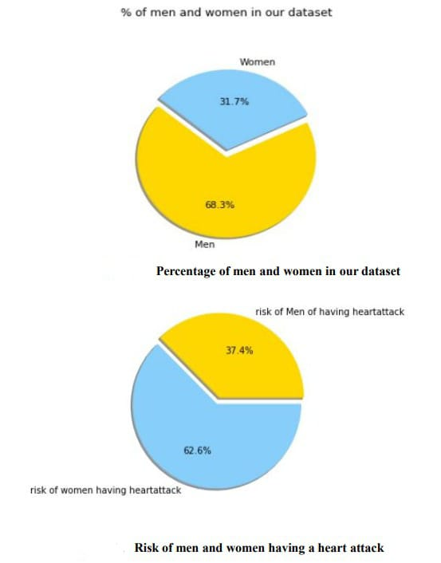
RESULTS FROM THE TEST DATA SET:
We have done extrapolation of data set in regards to heart disease on basis of various factors which are Sex, Age, Blood pressure, Serum cholesterol and so.

Slide 75
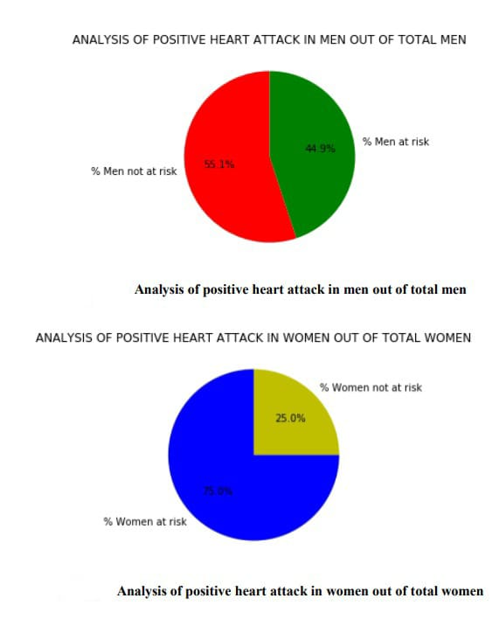
ANALYSIS OF POSITIVE HEART ATTACK IN MEN OUT OF TOTAL MEN AND WOMEN OUT OF TOTAL WOMEN:

Slide 76
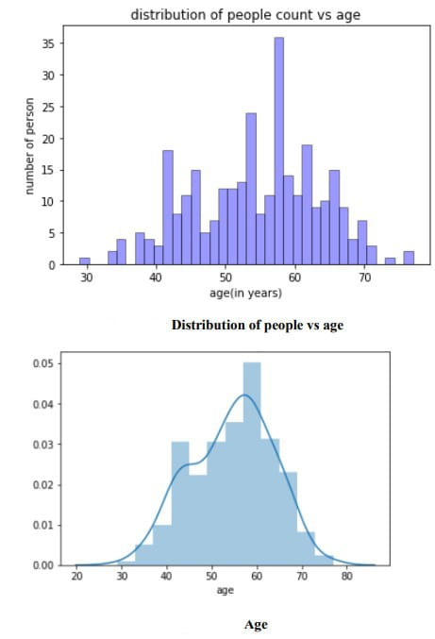
Distribution of people vs age:

Slide 77
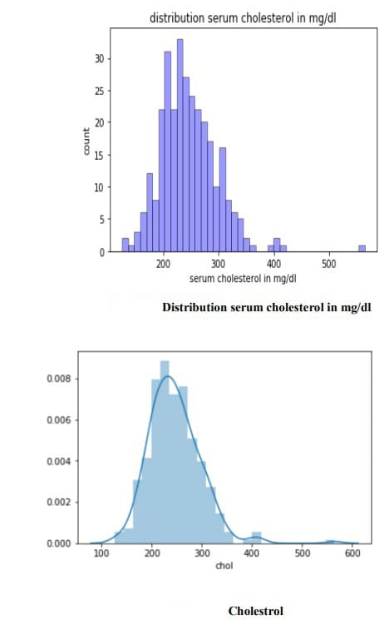
Distribution serum cholesterol in mg/dl:

Slide 78
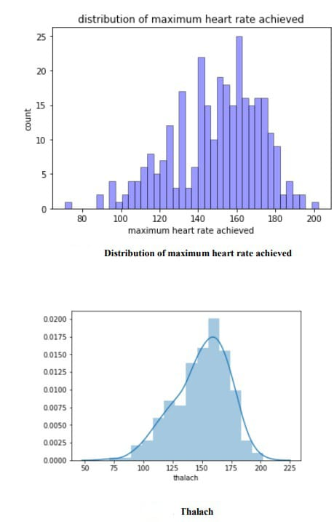
Distribution of maximum heart rate achieved:

Slide 79
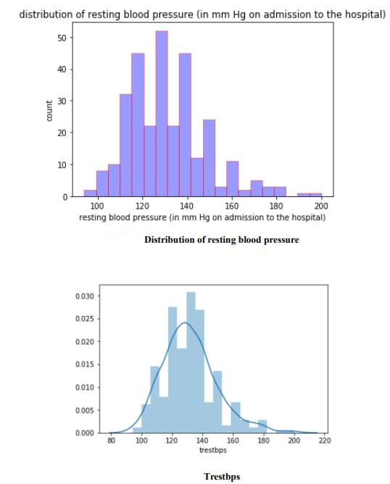
Distribution of resting blood pressure:

Slide 80
RESULTS :
After performing the machine learning approach for training and testing we find that accuracy of the Random Forest is better compared to other algorithms. Accuracy is calculated with the support of the confusion matrix of each algorithm, here the number count of TP, TN, FP, FN is given and using the equation of accuracy, value has been calculated and it is concluded that extreme gradient boosting is best with 95.08% accuracy and the comparison is shown below.
TABLE: Accuracy comparison of algorithms Algorithm Accuracy
Algorithms | Accuracy %
Logistic Regression | 85.25%
Naïve Bayes | 85.25%
SVM | 81.97%
K-Nearest Neighbors | 67.21%
Decision Tree | 81.97%
Random Forest | 95.08%
XG-Boost | 85.25%
Neural Network | 80.33%
Ada-Boost | 73.6%

Slide 81
CONCLUSION AND FUTURE WORK:
CONCLUSION:
• Heart diseases are a major killer in India and throughout the world, application of promising technology like machine learning to the initial prediction of heart diseases will have a profound impact on society. The early prognosis of heart disease can aid in making decisions on lifestyle changes in high-risk patients and in turn reduce the complications, which can be a great milestone in the field of medicine. The number of people facing heart diseases is on a raise each year. This prompts for its early diagnosis and treatment. The utilization of suitable technology support in this regard can prove to be highly beneficial to the medical fraternity and patients. In this paper, the seven different machine learning algorithms used to measure the performance are SVM, Decision Tree, Random Forest, Naïve Bayes, Logistic Regression, Adaptive Boosting, and XG Boost ANN , KNN, Linear Regression, DNN Extreme gradient boosting applied on the dataset. The expected attributes leading to heart disease in patients are available in the dataset which contains 76 features and 14 important features that are useful to evaluate the system are selected among them. If all the features taken into the consideration, then the efficiency of the system the author gets is less. To increase efficiency, attribute selection is done. In this n features have to be selected for evaluating the model which gives more accuracy. The correlation of some features in the dataset is almost equal and so they are removed. If all the attributes present in the dataset are taken into account, then the efficiency decreases considerably. All the Eleven machine learning methods accuracies are compared based on which one prediction model is generated. Hence, the aim is to use various evaluation metrics like confusion matrix, accuracy, precision, recall, and f1-score which predicts the disease efficiently. Comparing all seven the extreme gradient boosting classifier gives the highest accuracy of 95.08%
FUTURE WORK :
The work done here trains the system with a limited number of datasets. The machine learning algorithms become more accurate once they are fed with a huge number of data sets. So, this system can be trained with a huge number of data sets that would increase the accuracy in predicting the heart diseases. The analysis part of the system is done, and in order to be more useful can be integrated with electronic systems which give the system real-time inputs and would help the patient get the results then and there. There are multiple combinations of algorithms that can be tested against these data sets in order to yield better results.
For the Future Scope more machine learning approach will be used for best analysis of the heart diseases and for earlier prediction of diseases so that the rate of the death cases can be minimized by the awareness about the diseases. The analysis part of the system is done, and in order to be more useful can be integrated with electronic systems which give the system real-time inputs and would help the patient get the results then and there. There are multiple combinations of algorithms that can be tested against these data sets in order to yield better results.

Slide 82
REFERENCES:
[1] Animesh Hazra, Arkomita Mukherjee, Amit Gupta, Asmita Mukherjee, “Heart Disease Diagnosis and Prediction Using Machine Learning and Data Mining Techniques: A Review”, Research Gate Publications, July 2017, pp.2137-2159.
[2] V. Krishnaiah, G. Narsimha, N. Subhash Chandra,“Heart Disease Prediction System using Data Mining Techniques and Intelligent Fuzzy Approach: A Review”,International Journal of Computer Applications,February 2016.
[3] Guizhou Hu, Martin M. Root,“Building Prediction Models for Coronary Heart Disease by Synthesizing Multiple Longitudinal Research Findings”, European Science of Cardiology, 10 May 2005.
[4] T.Mythili, Dev Mukherji, Nikita Padaila and Abhiram Naidu, “A Heart Disease Prediction Model using SVM- Decision Trees- Logistic Regression (SDL)”,International Journal of Computer Applications, vol.68,16 April 2013
[5] Nimai Chand Das Adhikari, Arpana Alka, and rajat Garg, “HPPS: Heart Problem Prediction System using Machine Learning”.
[6] K. Polaraju, D. Durga Prasad, “Prediction of Heart Disease using Multiple Linear Regression Model”,International Journal of Engineering Development and Research Development, ISSN:2321-9939, 2017.
[7] Marjia Sultana, Afrin Haider, “Heart Disease Prediction using WEKA tool and 10-Fold cross-validation”, The Institute of Electrical and Electronics Engineers, March 2017.
[8] Dr.S.Seema Shedole, Kumari Deepika, “Predictive analytics to prevent and control chronic disease”, https://www.researchgate.net/punlication/316530782,January 2016.
[9] Ashok kumar Dwivedi, “Evaluate the performance of different machine learning techniques for prediction of heart disease using ten-fold cross-validation”, Springer, 17 September 2016.
[10] Megha Shahi, R. Kaur Gurm, “Heart Disease Prediction System using Data Mining Techniques”, Orient J. Computer Science Technology, vol.6 2017, pp.457-466
[11] Purushottam, Prof. (Dr.) Kanak Saxena, Richa Sharma, “Efficient Heart Disease Prediction System”, 2016, pp.962-969

